Slide 1
<DATA STRUCTURES AND ALGORITHM>

Slide 2
IV. SEARCHING

Slide 3
SEARCHING
In computer science, searching is the process of finding an item with specified properties from a collection of items. The items may be stored as records in a database, simple data elements in arrays, text in files, nodes in trees, vertices and edges in graphs, or they may be elements of other search spaces.

Slide 4
WHY DO WE NEED SEARCHING?
Searching is one of the core computer science algorithms. We know that today’s computers store a lot of information. To retrieve this information proficiently we need very efficient searching algorithms. There are certain ways of organizing the data that improves the searching process. That means, if we keep the data in proper order, it is easy to search the required element. Sorting is one of the techniques for making the elements ordered. In this chapter we will see different searching algorithms.

Slide 5
TYPES OF SEARCHING
Following are the types of searches(We will be discussing the ones in bold):
Unordered Linear Search
Sorted/Ordered Linear Search
Binary Search
Interpolation search
Binary Search Trees (operates on trees and refer Trees chapter)
Symbol Tables and Hashing
String Searching Algorithms: Tries, Ternary Search and Suffix Trees

Slide 6
UNORDERED LINEAR SEARCH
Let us assume we are given an array where the order of the elements is not known. That means the elements of the array are not sorted. In this case, to search for an element we have to scan the complete array and see if the element is there in the given list or not.
Time complexity: O(n), in the worst case we need to scan the complete array.
Space complexity: O(1).
Eg: unorderedlinearsearch.c

Slide 7
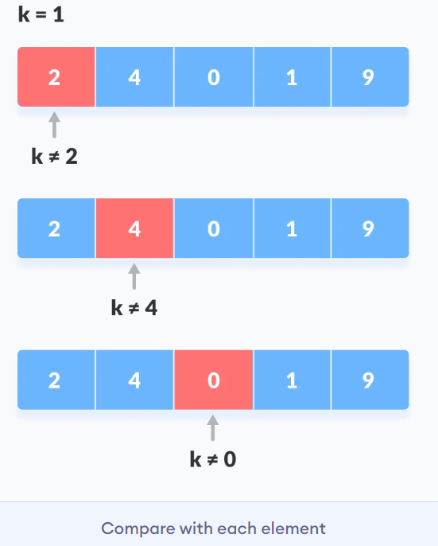
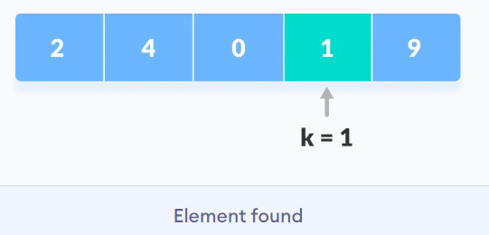
UNORDERED LINEAR SEARCH

Slide 8
ORDERED LINEAR SEARCH
If the elements of the array are already sorted, then in many cases we don’t have to scan the complete array to see if the element is there in the given array or not.
Time complexity of this algorithm is O(n).This is because in the worst case we need to scan the complete array.
Space complexity: O(1).
Eg: orderedlinearsearch.c

Slide 9
BINARY SEARCH
Let us consider the problem of searching a word in a dictionary. Typically, we directly go to some approximate page [say, middle page] and start searching from that point. If the name that we are searching is the same then the search is complete. If the page is before the selected pages then apply the same process for the first half; otherwise apply the same process to the second half.
Binary search also works in the same way. The algorithm applying such a strategy is referred to as binary search algorithm.

Slide 10
BINARY SEARCH
Binary search is a fast search algorithm with run-time complexity of Ο(log n). This search algorithm works on sorted data and on the principle of divide and conquer.
The idea of binary search is to use the information that the array is sorted and reduce the time complexity to O(Log n).
Eg: binarysearch.c

Slide 11
BINARY SEARCH
The basic steps to perform Binary Search are:
Begin with an interval covering the whole array.
If the value of the search key is less than the item in the middle of the interval, narrow the interval to the lower half.
Otherwise, narrow it to the upper half.
Repeatedly check until the value is found or the interval is empty.

Slide 12
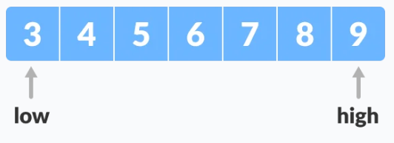
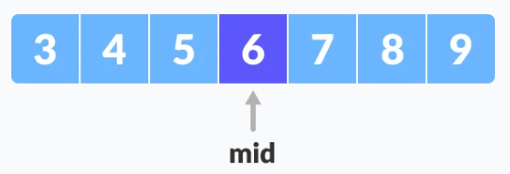
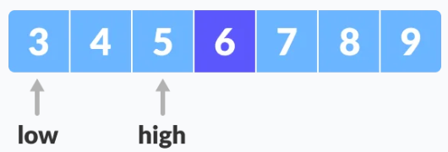
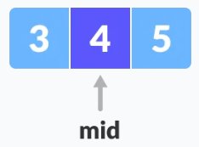
BINARY SEARCH
Search for 4
mid = low + (high - low) / 2

Slide 13
REFERENCES
Data Structures And Algorithms Made Easy: Data Structures And Algorithmic Puzzles by Narasimha Karumanchi
https://www.programiz.com/
https://www.geeksforgeeks.org/
https://www.tutorialspoint.com/

